Slide 1
Teaching AI to play Atari Ice Hockey game using gameplay videos
Presenter: Xu Yangyang [u6325688]
Supervisor: Dr. Penny Kyburz
COMP8755

Slide 2
Content
Introduction
Background
Experimental Setup
Methods
Results
Conclusion
Q&A

Slide 3
Introduction - Motivations
Smarter playmate [1][2]
Can AI learn from others’ gameplay videos
How to use YouTube videos

Slide 4
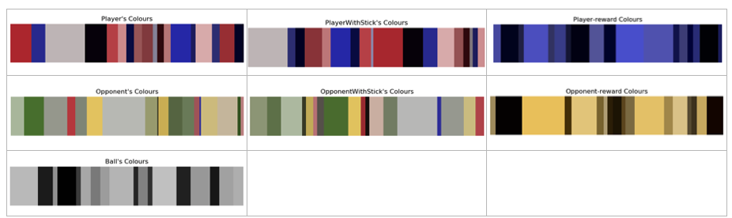
Introduction – Problem challenges
Videos have different resolutions and sizes.
Two players, but we control only one at a time
YouTube gameplay videos do not have action records.

Slide 5
Introduction - Scope
Object detection (supervised learning)
State representation: recognise player with ice hockey stick
Imitation learning (inverse reinforcement learning)
Learn from others

Slide 6
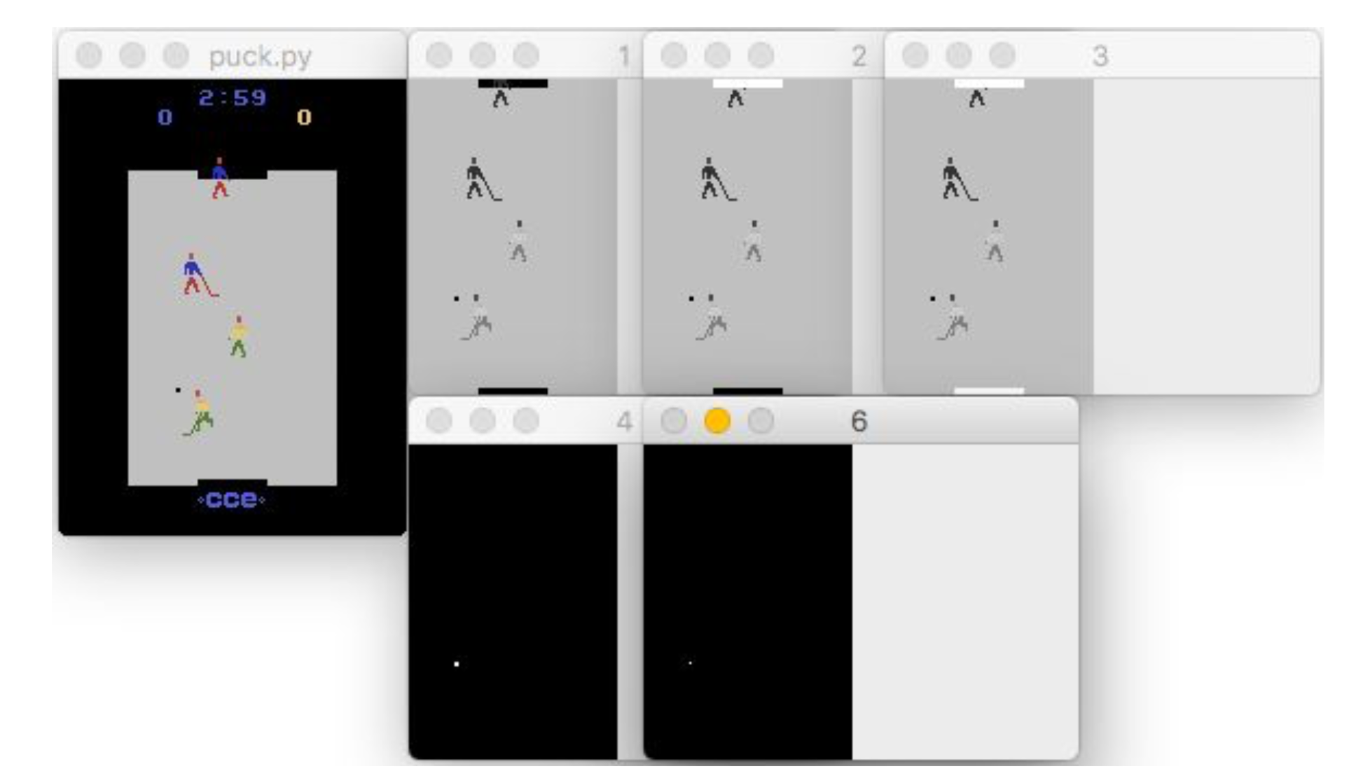
Introduction – Related Work[3]
[agentplayer1_xpos, agentplayer1_ypos, agentplayer2_xpos, agentplayer2_ypos, opponentplayer1_xpos, opponentplayer1_ypos, opponentplayer2_xpos, opponentplayer2_ypos, puck_xpos, puck_ypos, timer_startgame, timer_lastgoal]

Slide 7
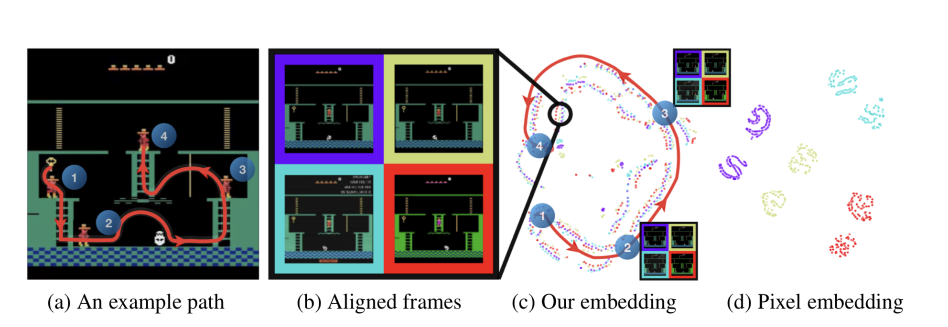
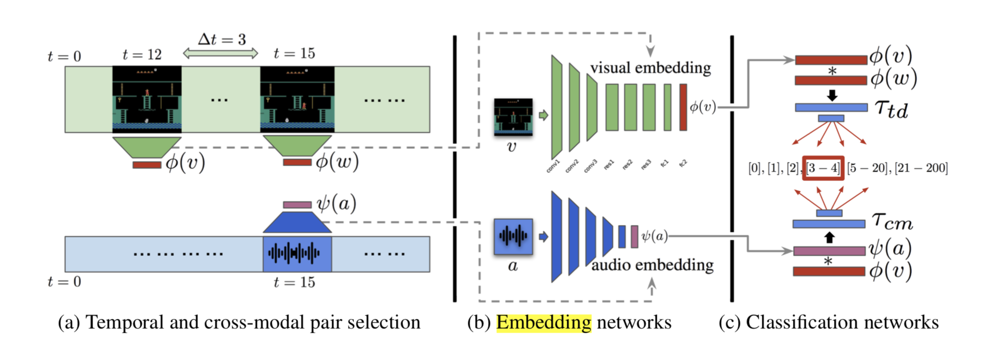
Introduction – Related Work [4]
Temporal distance classification
Cross-modal temporal
distance classification

Slide 8
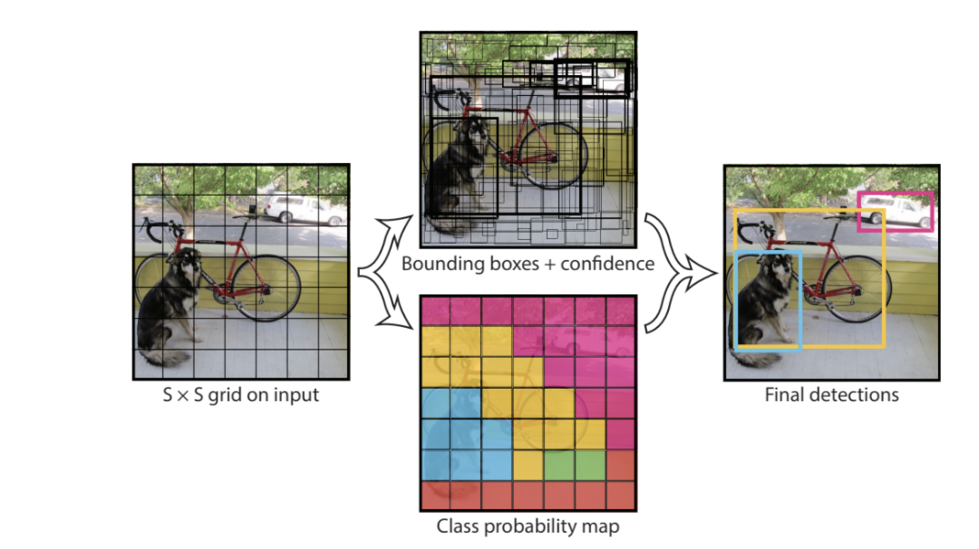
Background - YOLO [5]

Slide 9
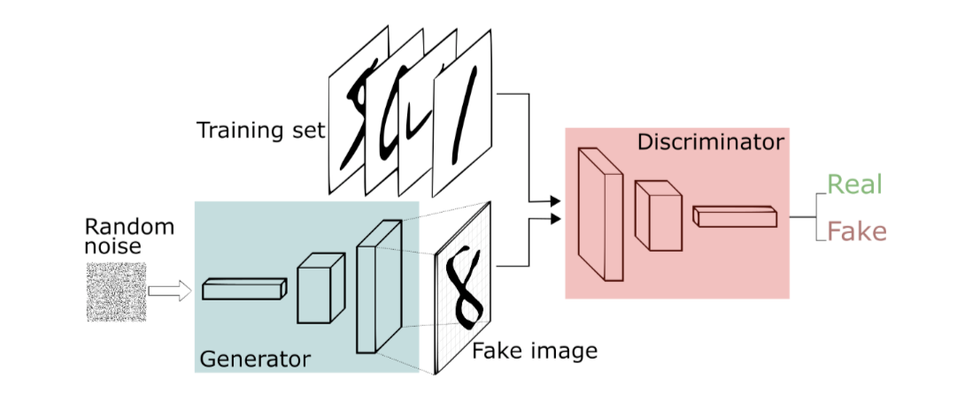
Background - GAN [6]

Slide 10
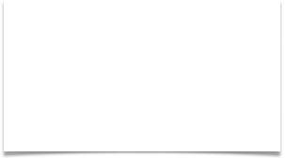
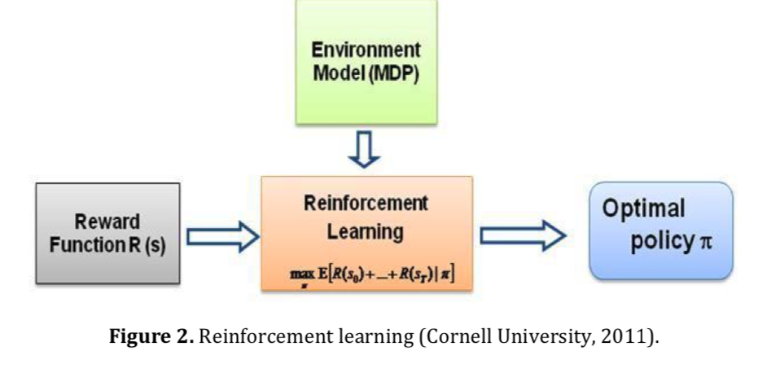
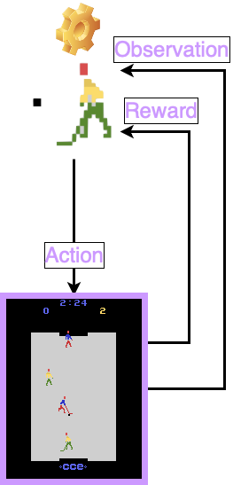

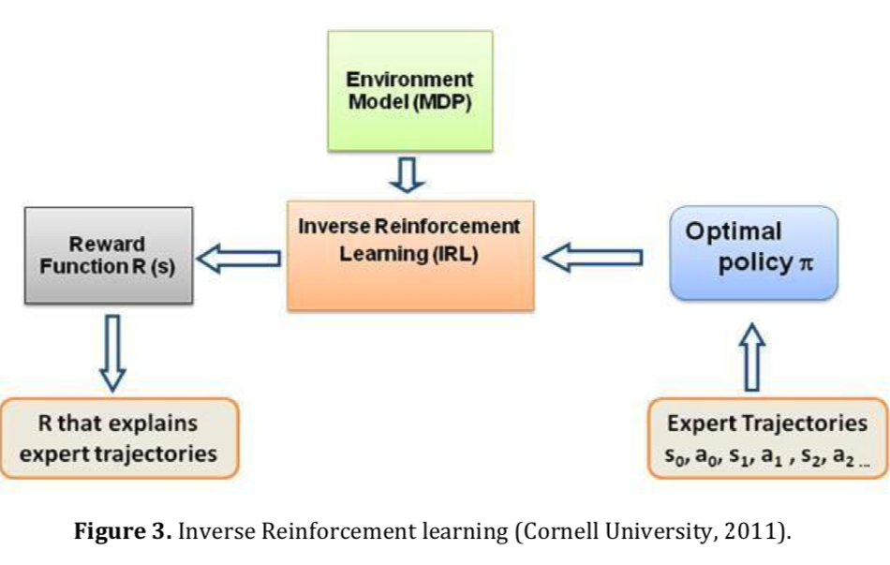
Background - Reinforcement Learning
Markov Decision Process (MDP):（State, Actions, Transition Probabilities, Reward）
Forward Reinforcement Learning
Pavaloiu, A., & Kose, U. (2017). Ethical artificial intelligence-an open question. arXiv preprint arXiv:1706.03021 [7].
Inverse Reinforcement Learning
Pavaloiu, A., & Kose, U. (2017). Ethical artificial intelligence-an open question. arXiv preprint arXiv:1706.03021 [7].

Slide 11
Experimental Setup
Python
GPU & CPU
Libraries:
Gym [8]
Darknet [9]

Slide 12
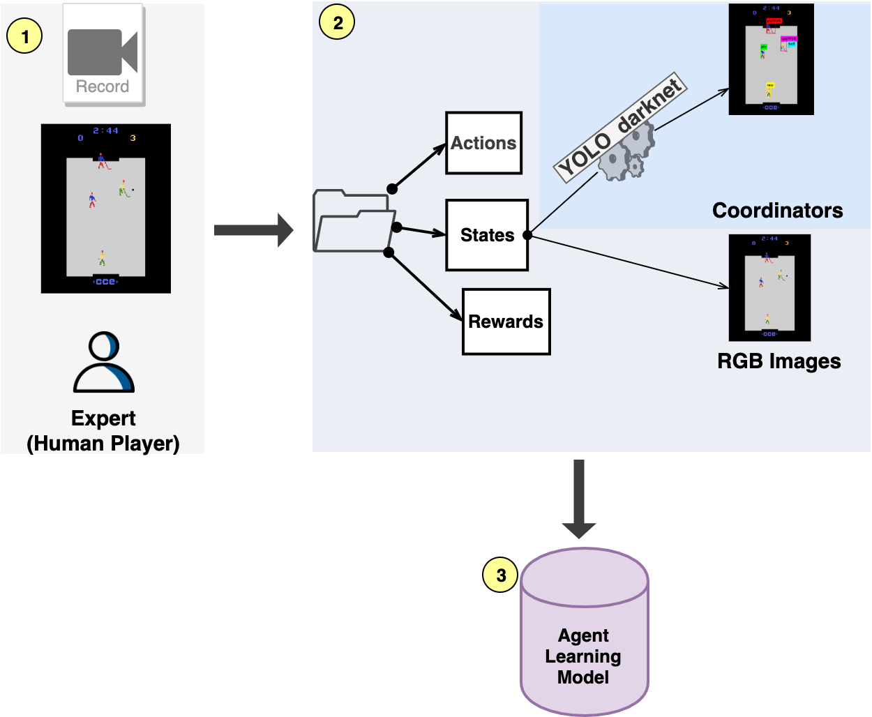
Method - Workflow

Slide 13
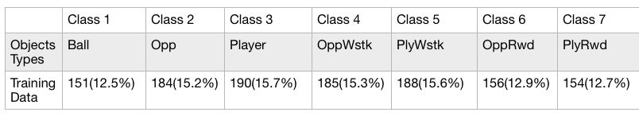
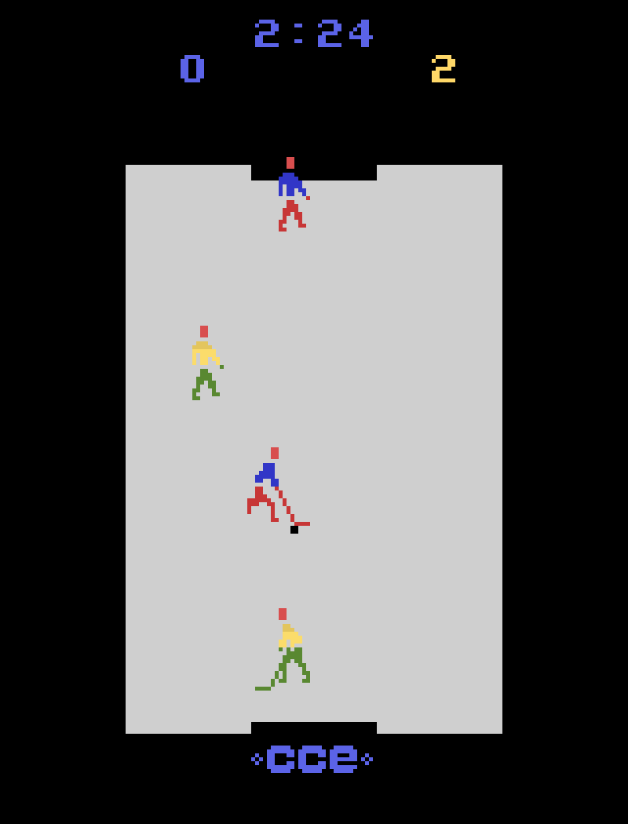
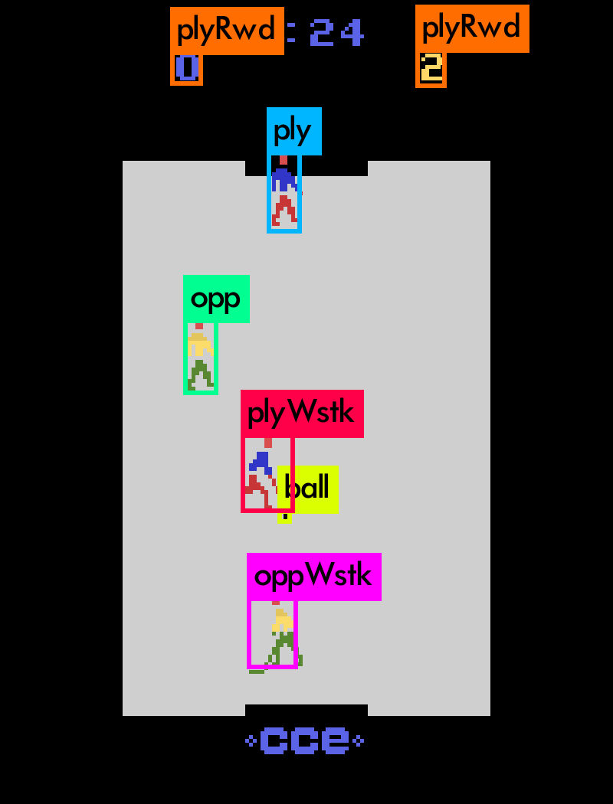
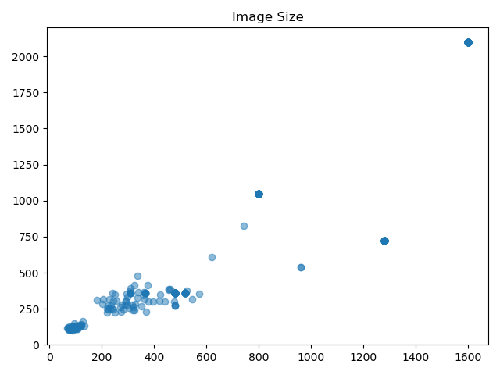
Method - State representation [10]
Current Object Detection Method:
One-Stage
YOLO(You Only Look Once)[2]
Total: 264 training images
Framework: Darknet[3]

Slide 14
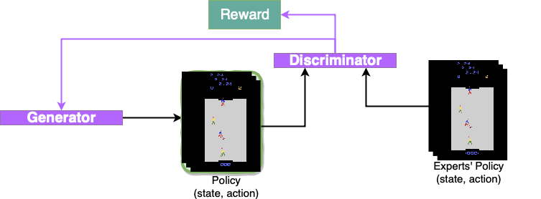
Method – Generative Adversarial Imitation Learning GAIL[11]

Slide 15
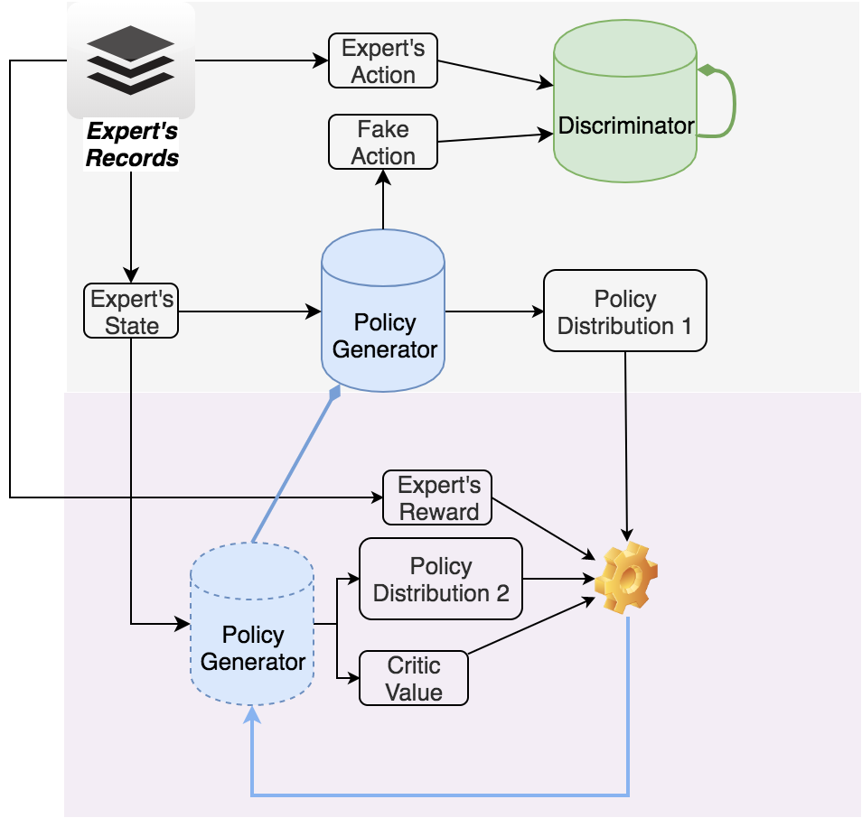
Method – Imitation Learning Model

Slide 16
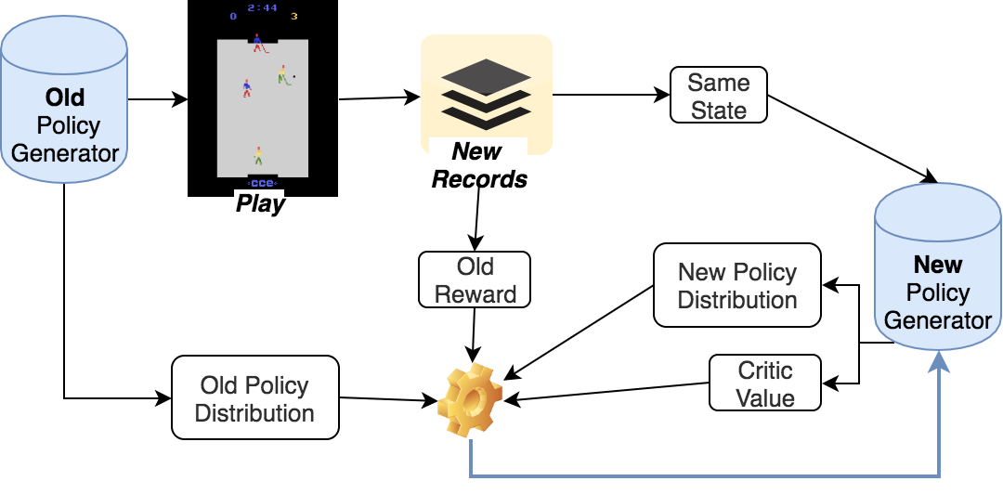
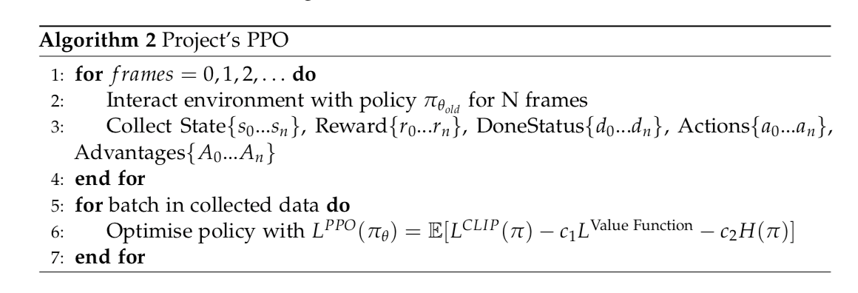
Method – PPO

Slide 17
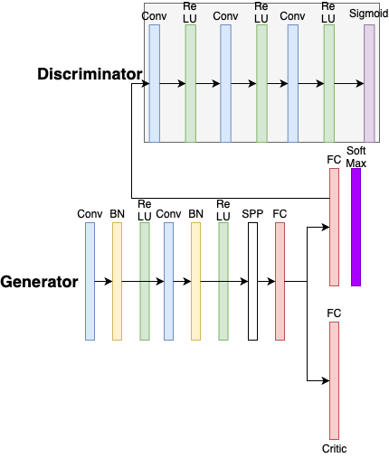
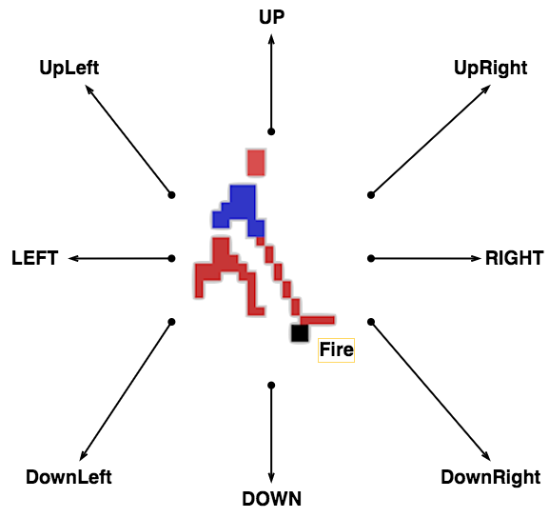
Method – CNN architecture [Image State]
Output:(1x1)
Intput: (state+action)
(1x19)
Output: (1x18)
Input: (3x160x210)
Output: (1x1)

Slide 18
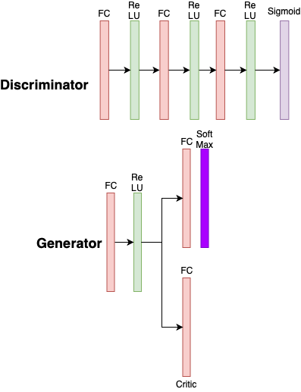
Method – CNN architecture [Location State]
Output:(1x1)
Intput: (state+action)
(1x21)
Output: (1x18)
Input: (1x20)
Output:(1x1)

Slide 19
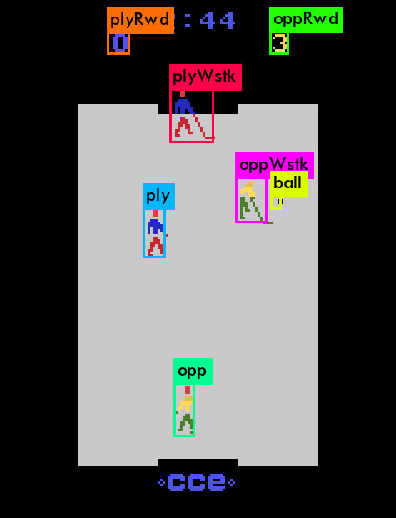
Result – Our YOLO detector

Slide 20
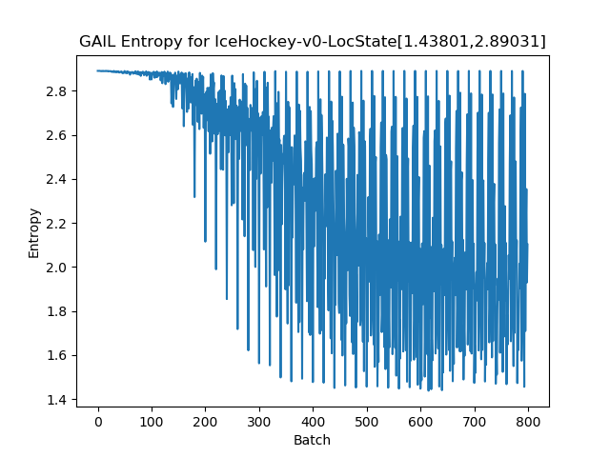
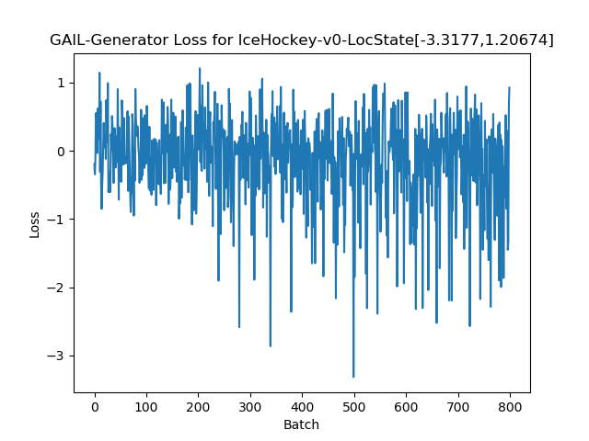
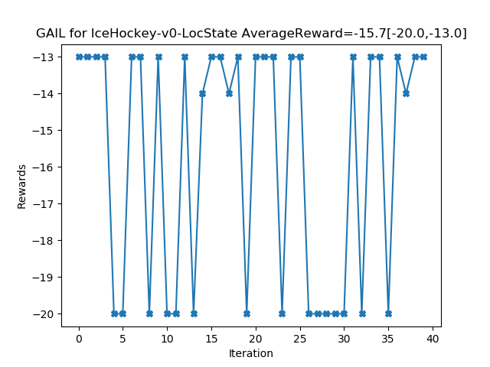
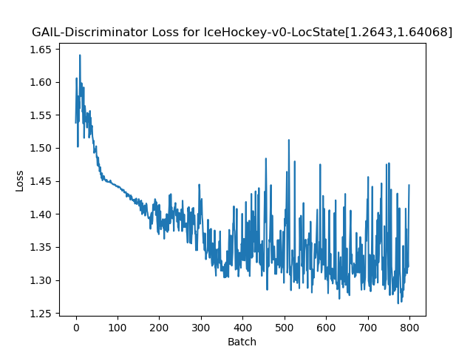
Result – Model
NO extra interaction. Location State

Slide 21
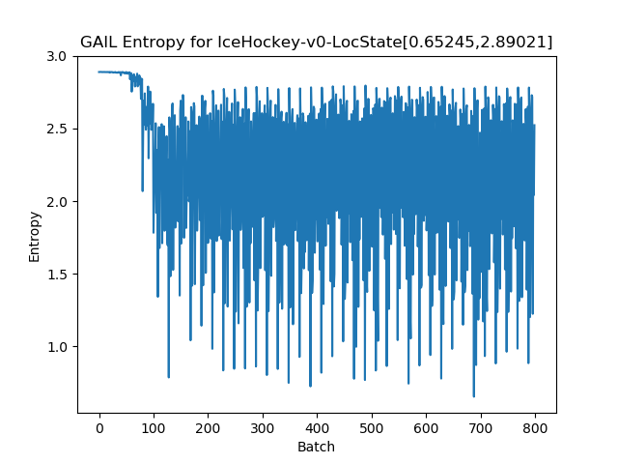
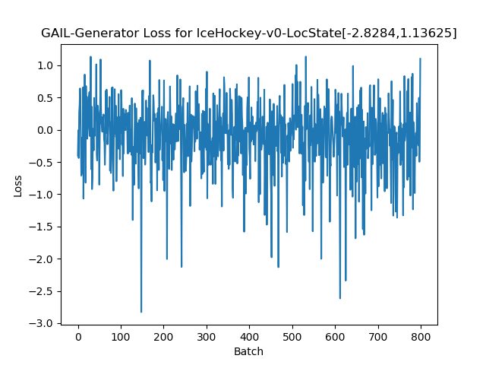
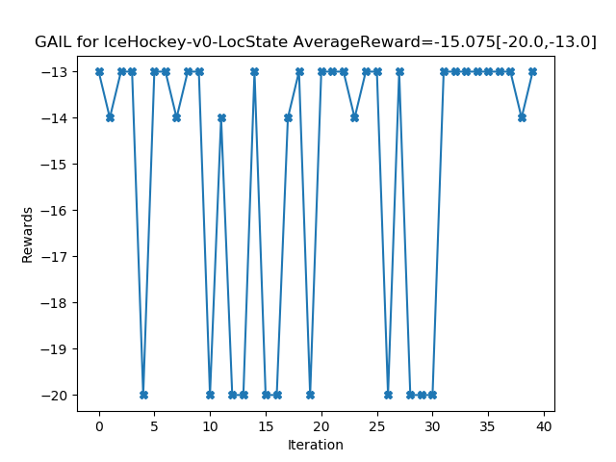
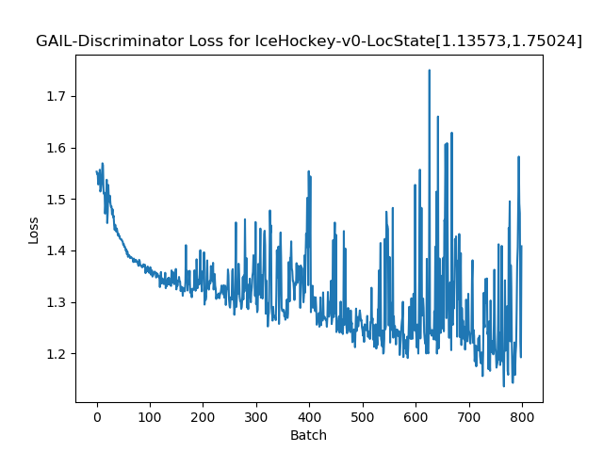
Result – Model
With extra interaction. Location State

Slide 22
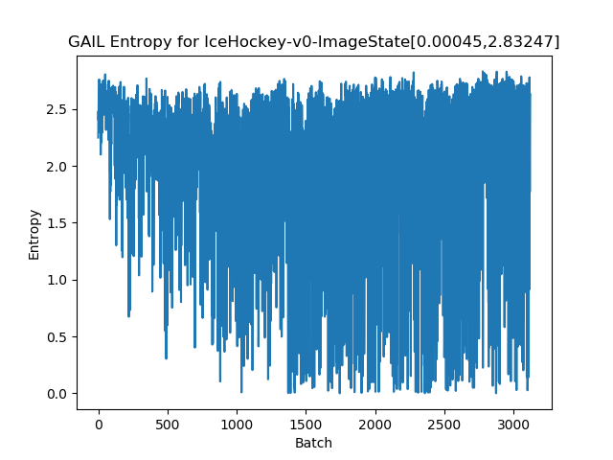
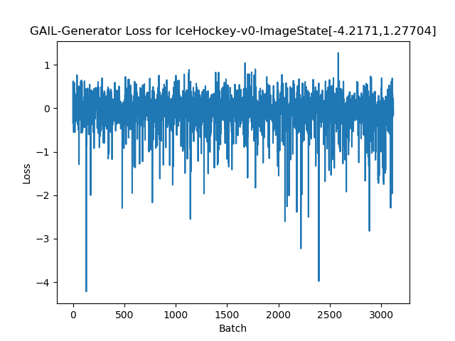
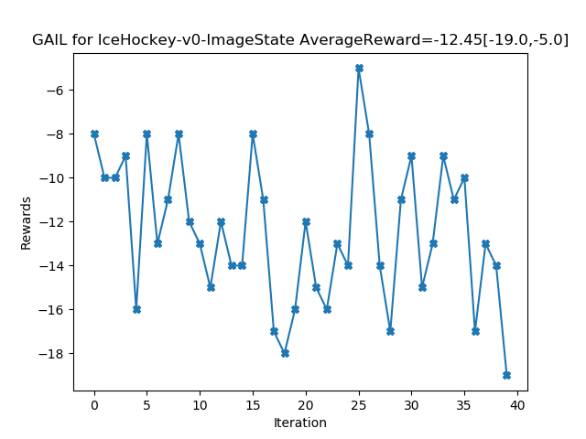
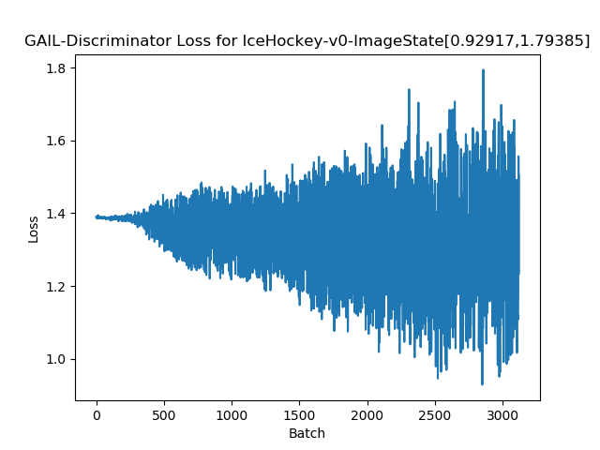
Result – Model
With extra interaction. Raw Image State

Slide 23
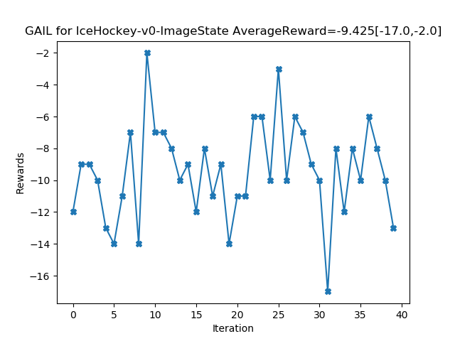
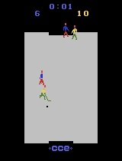
Result – AI best score Vs. Our best score

Slide 24
https://youtu.be/rgYOhhg0DUk https://www.youtube.com/watch?v=rgYOhhg0DUk
Result – Play with agent

Slide 25
Conclusion - Contribution
New data repository for OpenAI’s baseline [12]
No image-state expert’s data
Share it with GitHub people

Slide 26
Conclusion – Significant Findings
An non-expert data still allows agent to get higher mark by using PPO
Raw image’ performance > Location’s performance.
Prefer larger batch size

Slide 27
Conclusion – Future
Refine RGB-state model
Unsupervised behaviour learning algorithms
detect the game characters by their behaviours
Try evolutionary algorithm

Slide 28
References
[1] O. Vinyals et al., “StarCraft II: A New Challenge for Reinforcement Learning,” arXiv e-prints, p. arXiv:1708.04782, Aug. 2017.
[2] D. Silver et al., “Mastering the game of Go without human knowledge,” Nature, vol. 550, no. 7676, p. 354, 2017.
[3] E. Kabaghe and R. Roy, “AI Agent for Ice Hoceky Atari 2600.”
[4] Y. Aytar, T. Pfaff, D. Budden, T. Le Paine, Z. Wang, and N. de Freitas, “Playing hard exploration games by watching YouTube,” arXiv e-prints, p. arXiv:1805.11592, May 2018.
[5]J. Redmon and A. Farhadi, “Yolov3: An incremental improvement,” arXiv Prepr. arXiv1804.02767, 2018.
[6]Thalles, “A Short Introduction to Generative Adversarial Networks,” 2017
[7] Pavaloiu, A., & Kose, U. (2017). Ethical artificial intelligence-an open question. arXiv preprint arXiv:1706.03021.

Slide 29
References
[8] M. G. Bellemare, Y. Naddaf, J. Veness, and M. Bowling, “The Arcade Learning Environment: An Evaluation Platform for General Agents,” arXiv e-prints, p. arXiv:1207.4708, Jul. 2012.
[9] J. Redmon, “Darknet: Open Source Neural Networks in C.”
[10]J. Redmon, "YOLO: Real-Time Object Detection", Pjreddie.com, 2019. [Online]. Available: https://pjreddie.com/darknet/yolo/. [Accessed: 08- Aug- 2019].
[11] Ho, J., & Ermon, S. (2016). Generative adversarial imitation learning. In Advances in neural information processing systems (pp. 4565-4573).
[12] P. Dhariwal et al., “OpenAI Baselines,” GitHub repository. GitHub, 2017

